Slide 1
AirXGB
Tom Raczkowski

Slide 2
Question
Which are the most important factors when pricing an Airbnb?

Slide 3
Why is this question important?
With the rise of Airbnb, the job of pricing vacation rentals in large cities is shifting from massive hotel chains or agents to people with one or two properties and little domain knowledge.
- This presents us with a classic supply and demand problem.
Priced too high and they will be left with an empty property.
Priced too low and they are slashing their margins.

Slide 4
Methodology
Utilized a dataset managed by InsideAirbnb, a group who seeks to keep Airbnb honest by scraping the site and keeping the data for some cities freely available on the internet
Obtained and cleaned the data for 9 large American cities (4500+ listings in each market)
Compared the cities using the same model to see how similarly they behaved
Built a model to predict price bins (<$150, $151-$300, $301-$400, $401-$500) using Random Forest and XGBoost algorithms

Slide 5
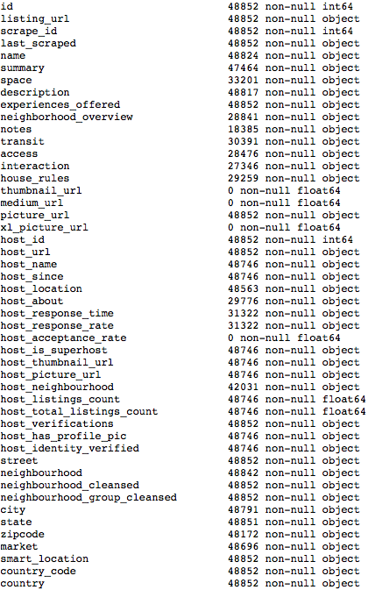
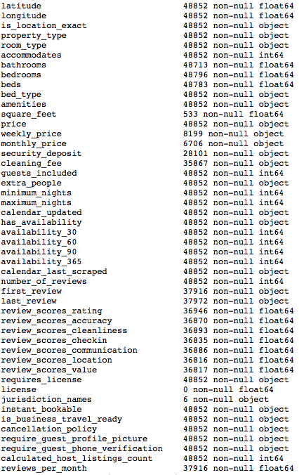

Assumptions and Preprocessing
Removed information related to the host because they are the ones setting the price.
-Host description, response time, etc.
Backfilled any columns I was planning on using with assumptions.
EX: If a host was marked as having 0 properties I would fill with 1

Slide 6
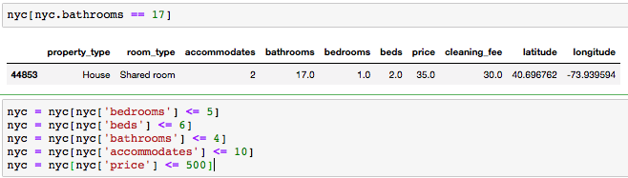
Simplifying Input for the Model
To predict more accurately, some portions of the data needed to be removed...
There were some listings that were outliers. Some were too expensive, and others had data that was just plain wrong.
EX: A shared room in Brooklyn with 1 bedroom and 17 bathrooms for $35.00 a night?
-I trimmed my data (losing around 3% of usable entries for NYC) to under $500.00 per night.

Slide 7
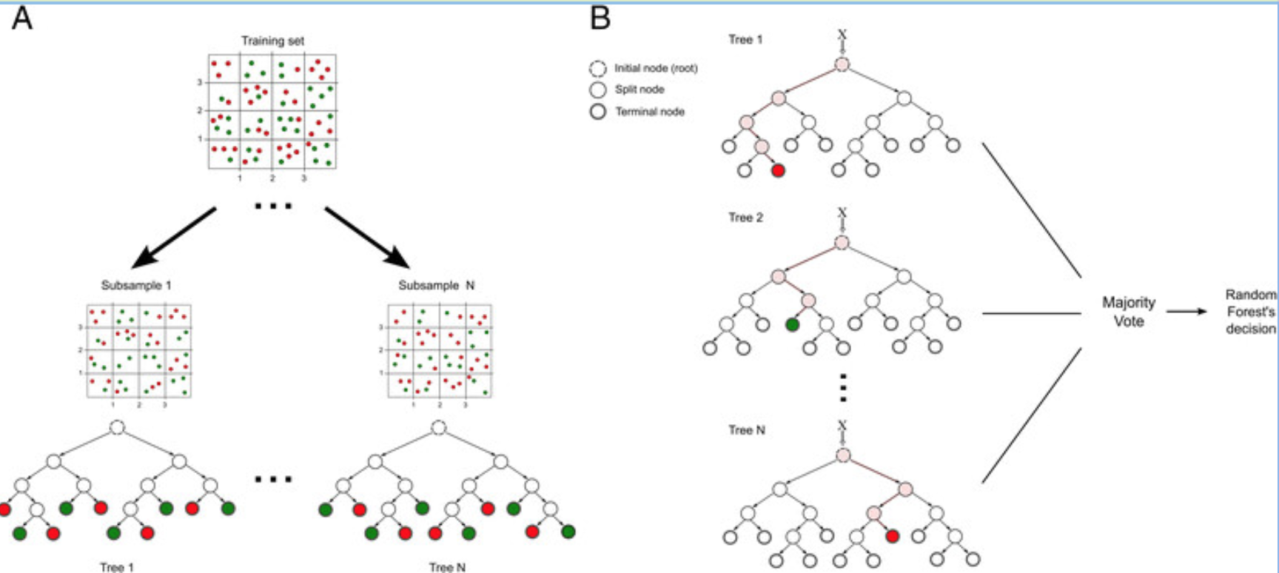
Models Used
Random Forest – This model builds decision trees, making splits at random and then aggregates them to lead to a less biased model in the end.
XGBoost – Also based on decision trees. It is one of the strongest predictive algorithms currently available and is based on gradient boosting.

Slide 8
Most Important Features
As the saying goes:
“Location, Location, Location!”
Latitude and Longitude were consistently at the top of the feature importance when it came to the models of all cities.
Both ~30%

Slide 9
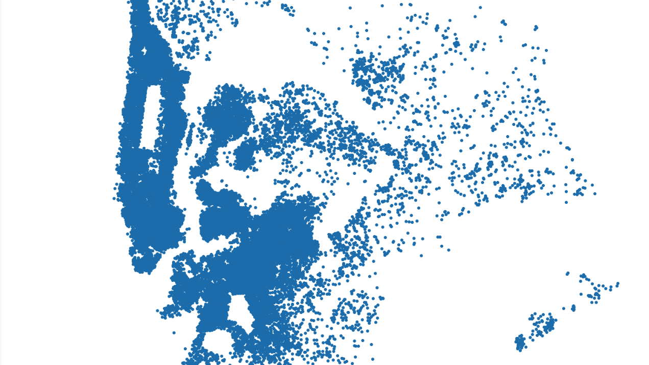
How can we use location?

Slide 10
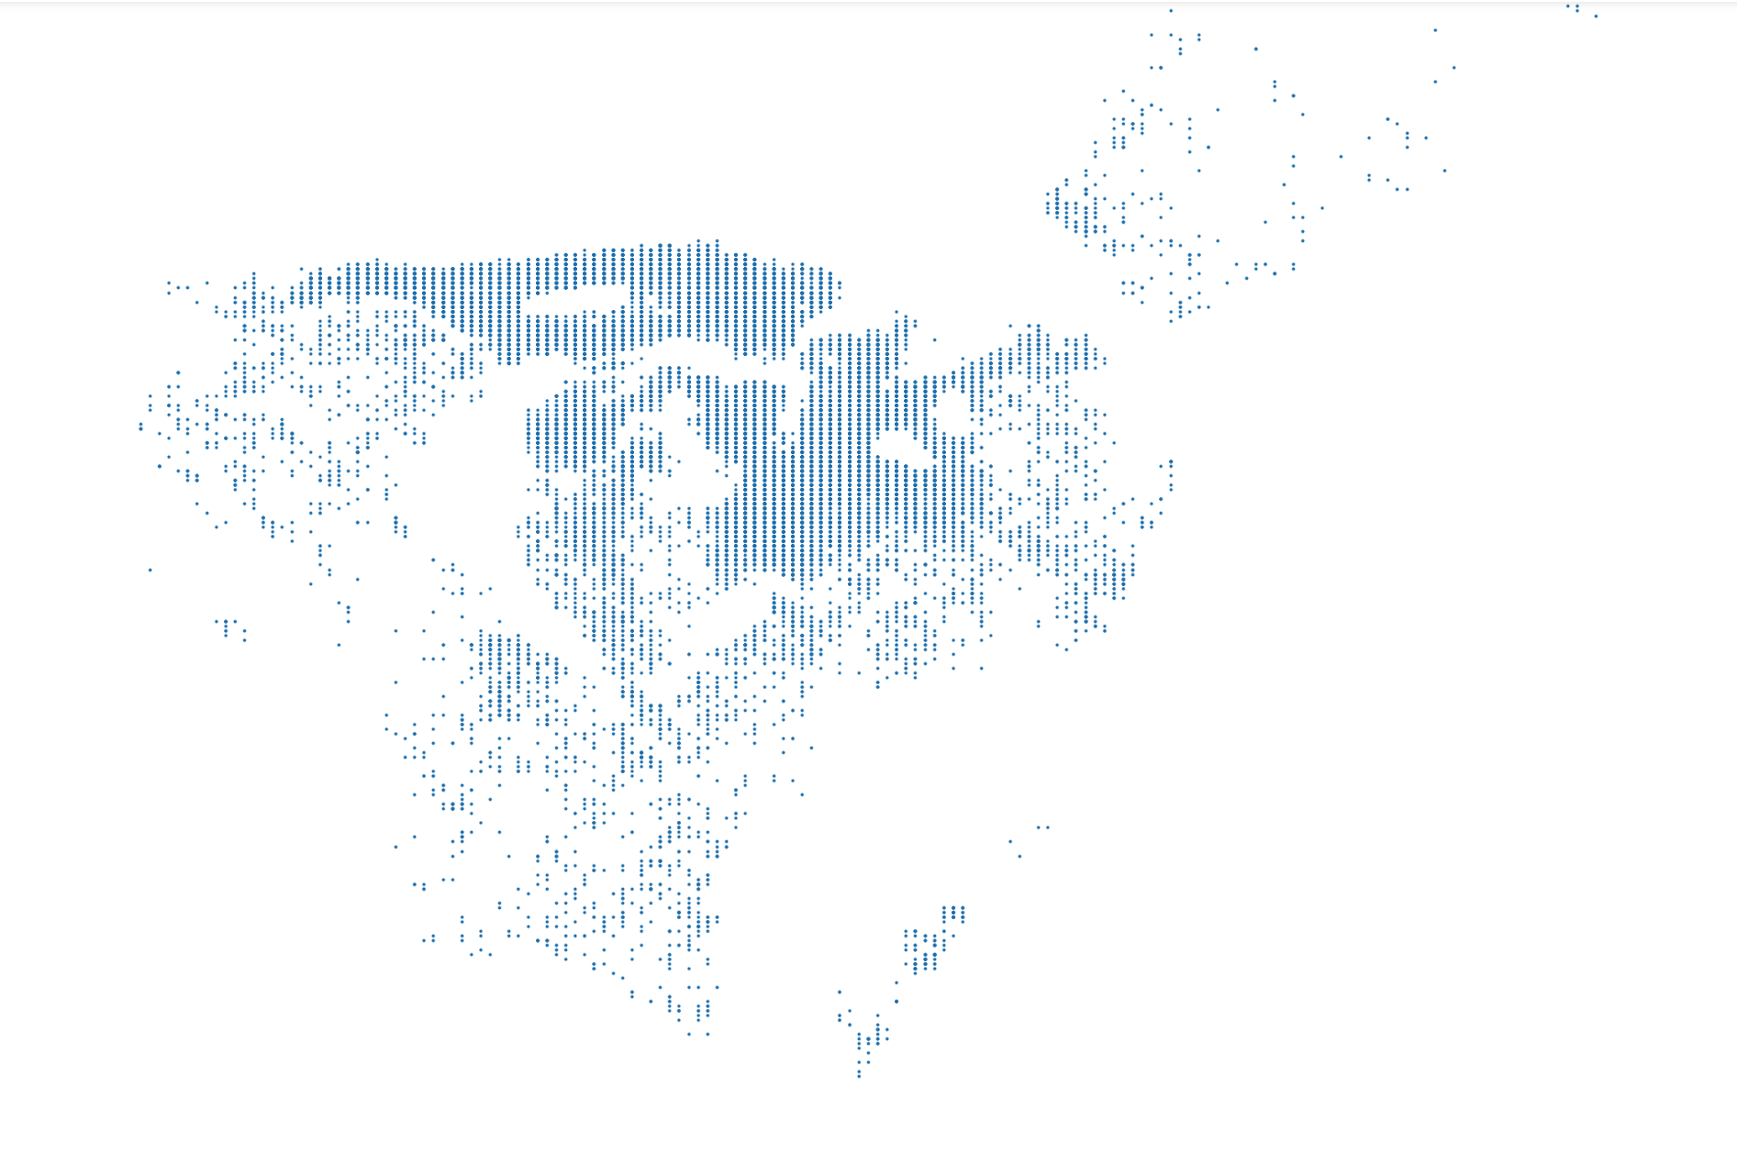
By neatening up the map!
By putting latitude and longitude components into bins, the computer is able to use them more effectively for prediction.

Slide 11
Other Notable Features
The number of bedrooms, bathrooms, and beds included in the rental.
Amenities that were included with the rental were also considered as part of the final model.
Common things like Wifi, TV, a hair dryer, etc.
Things denoting luxury such as a doorman, a pool, fireplace, etc.
Features which may be important for smaller subsets of people or families.
Disabled Parking spot
Ground floor access
Changing table
Outlet covers

Slide 12
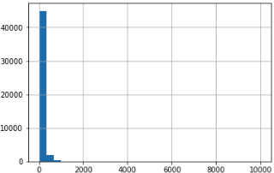
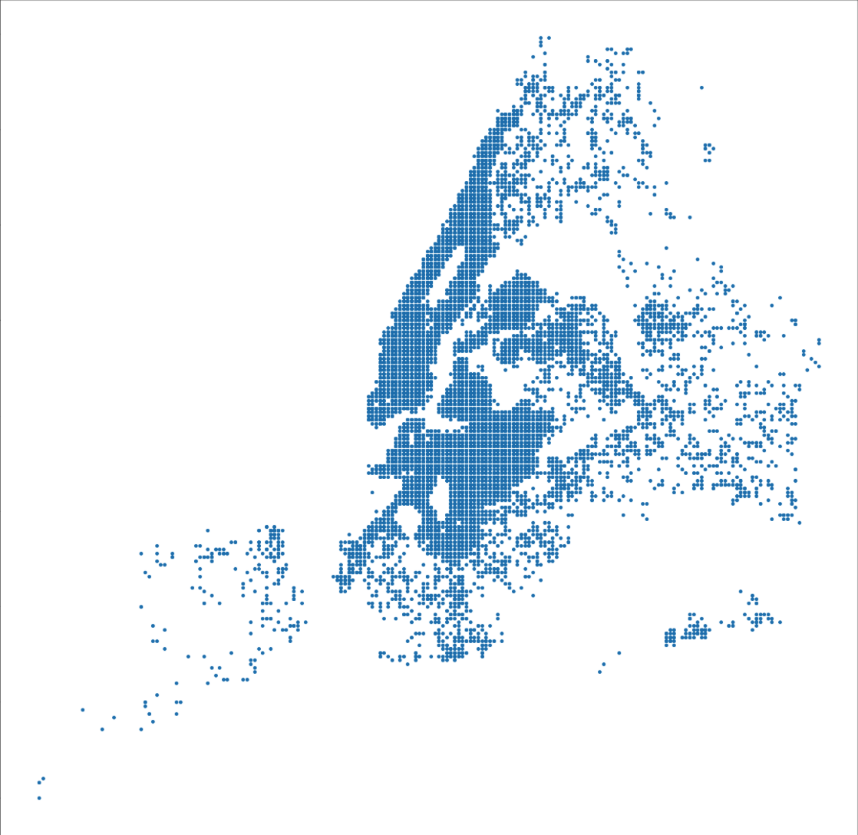
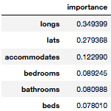
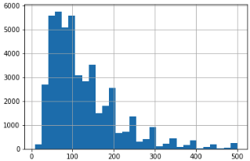
New York City
Top 3 Amenities (Phase 2):
Family/Kid Friendly: 6.49%
TV: 5.25%
Lock on Bedroom Door : 3.35%
Best Random Forest Accuracy: 71.11%
Best Xgboost Accuracy: 71.38%

Slide 13
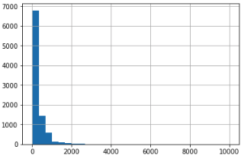
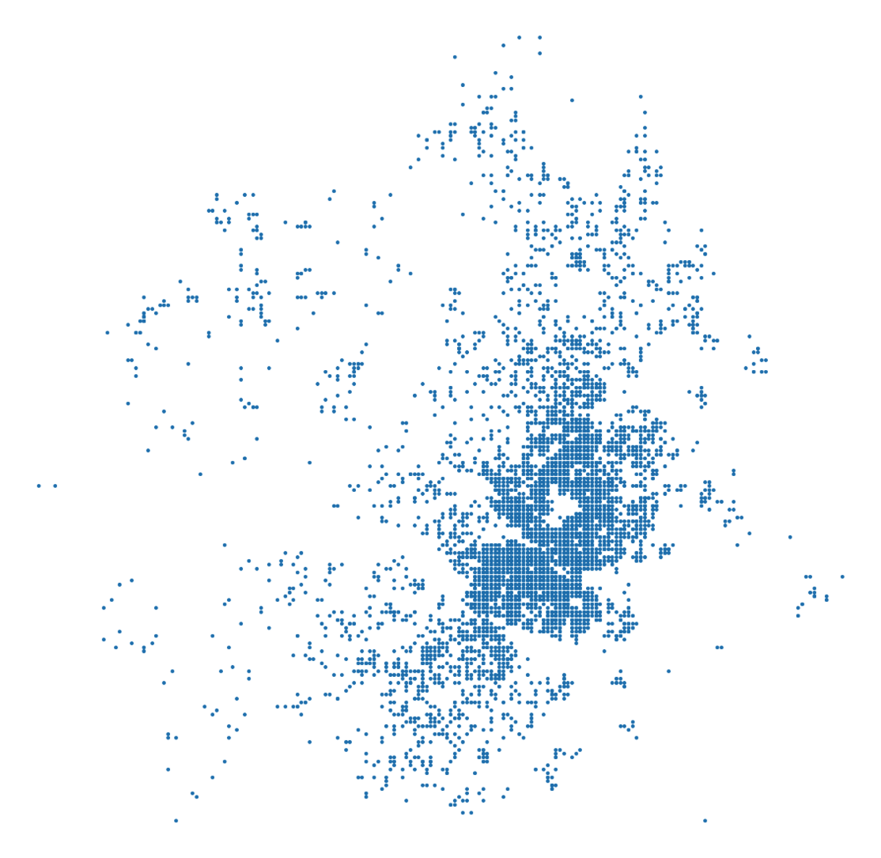
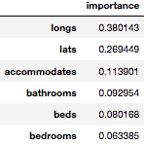
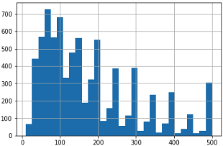
Austin
Top 3 Amenities (Phase 2):
Cable TV: 4.19%
Pets Live on The Property 2.49%
Lock on Bedroom Door : 2.11%
Best Random Forest Accuracy: 59.43%
Best Xgboost Accuracy: 58.58%

Slide 14
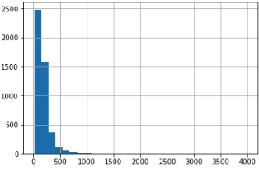
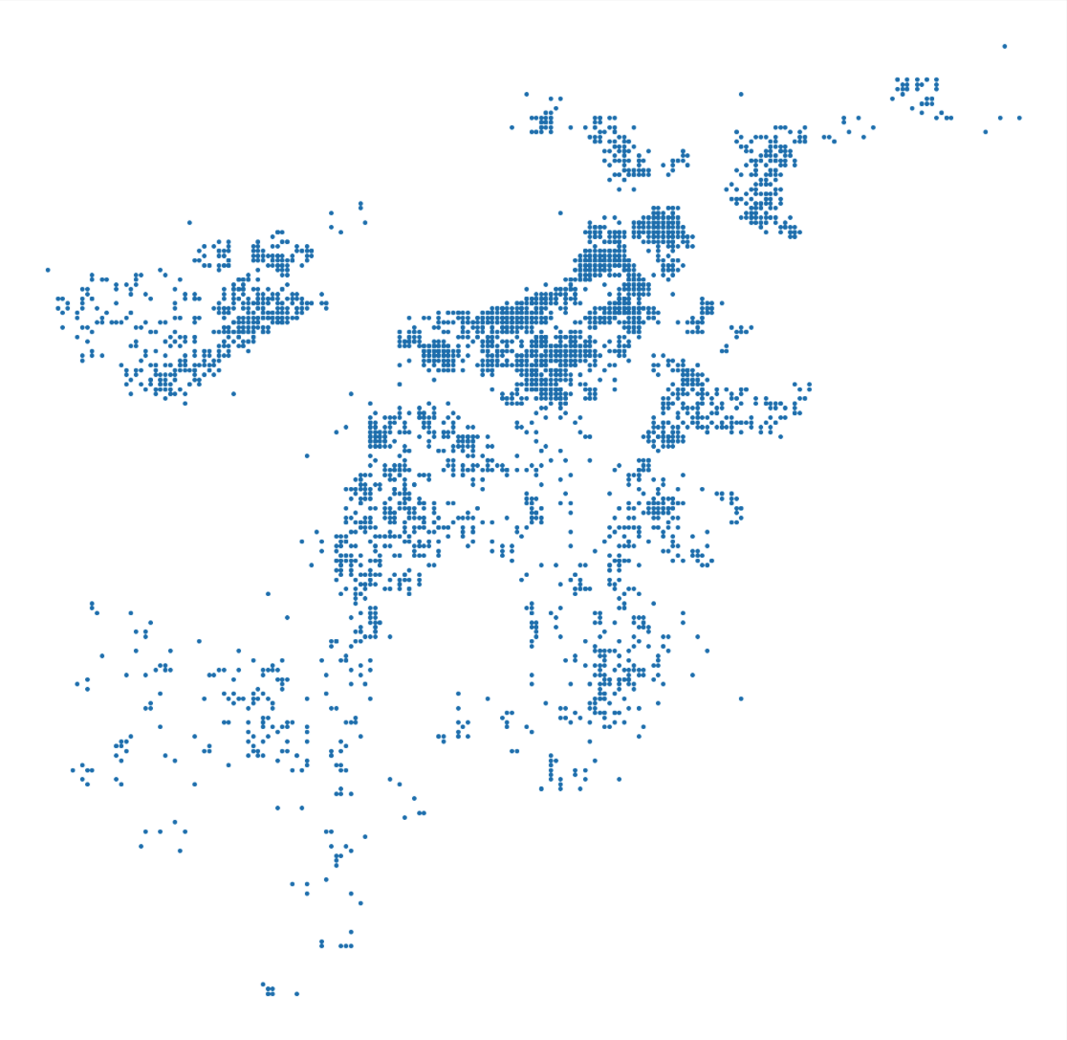
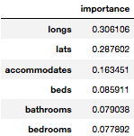
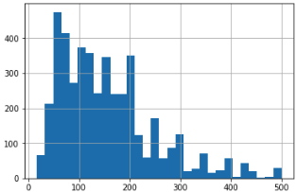
Boston
Top 3 Amenities (Phase 2):
TV: 15.0%
Family/Kid Friendly: 5.17%
Lock on Bedroom Door : 4.36%
Best Random Forest Accuracy: 70.43%
Best Xgboost Accuracy: 69.97%

Slide 15
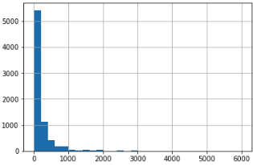
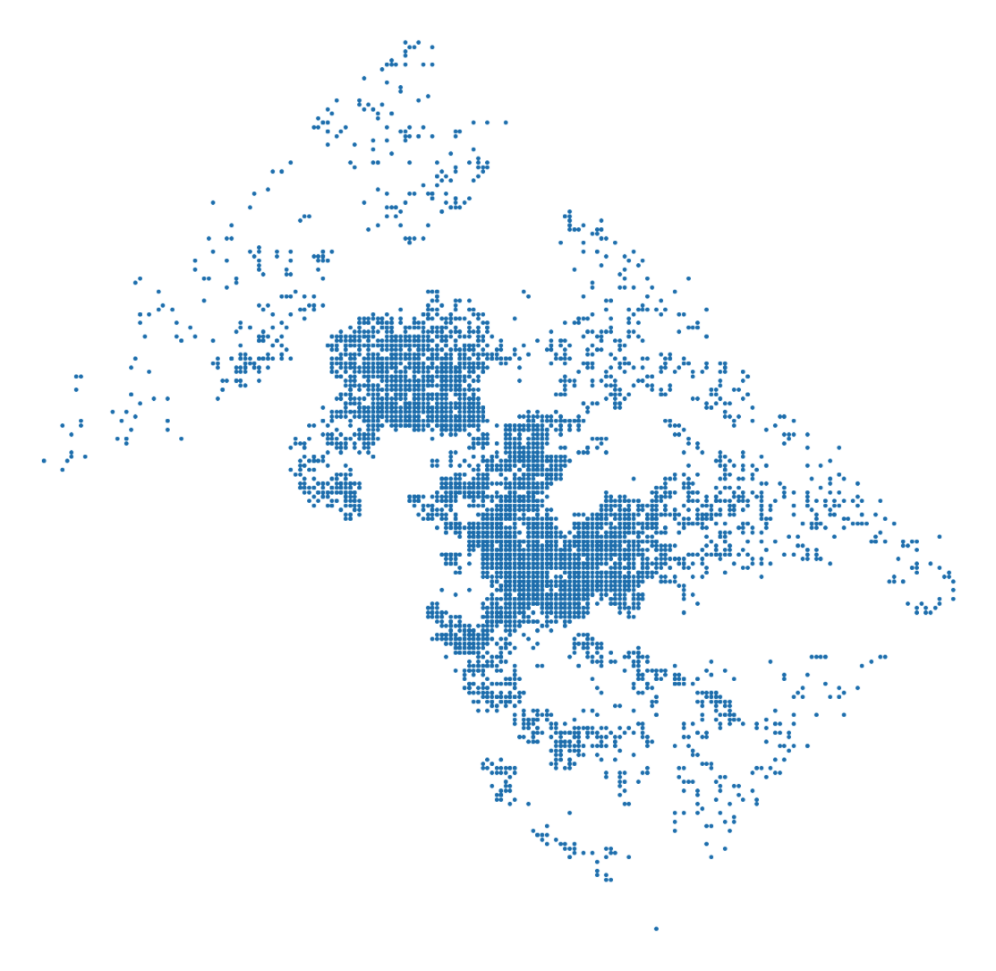
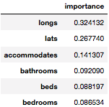
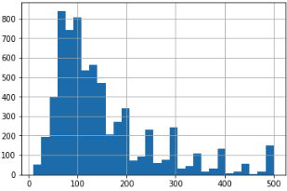
Washington DC
Top 3 Amenities (Phase 2):
TV: 6.12%
Family/Kid Friendly 4.48%
Gym: 3.15%
Best Random Forest Accuracy: 64.10%
Best Xgboost Accuracy: 63.19%

Slide 16
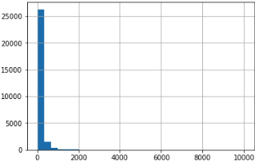
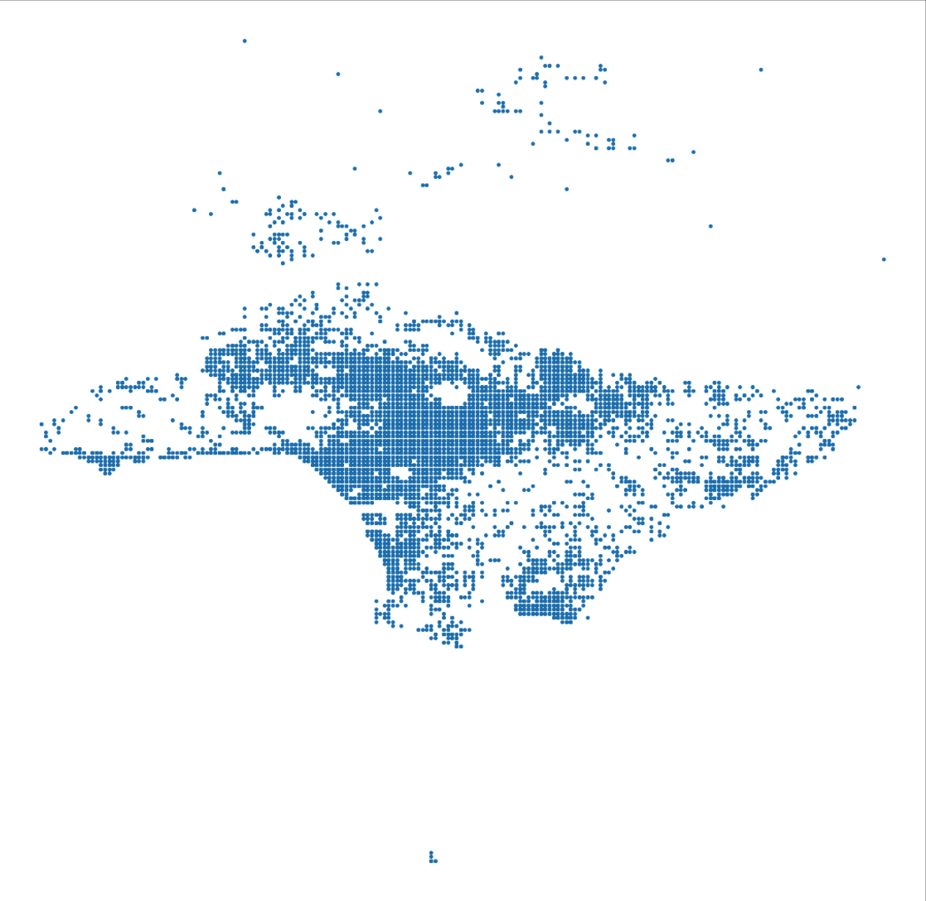
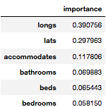
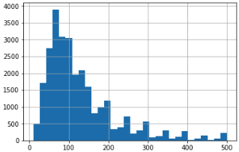
Los Angeles
Top 3 Amenities (Phase 2):
TV 4.92%
Family/Kid Friendly: 4.45%
Lock on Bedroom Door : 2.34%
Best Random Forest Accuracy: 69.36%
Best Xgboost Accuracy: 70.49%

Slide 17
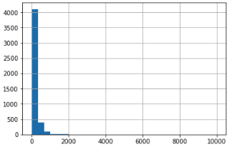
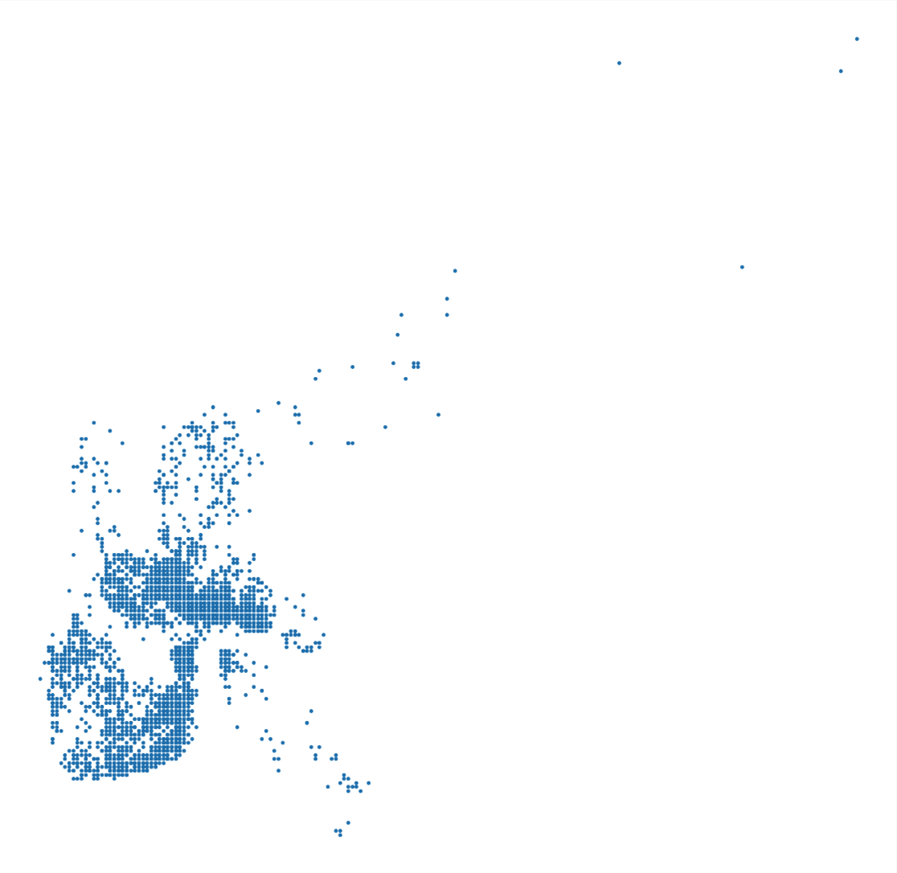
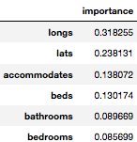
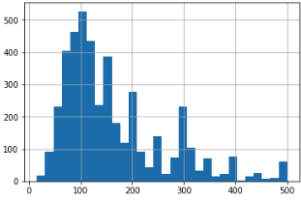
New Orleans
Top 3 Amenities (Phase 2):
Elevator 6.54%
Pets live on this property: 4.43%
Cable TV: 3.91%
Best Random Forest Accuracy: 57.28%
Best Xgboost: 61.10%

Slide 18
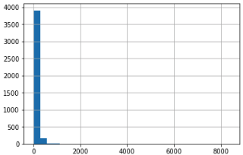
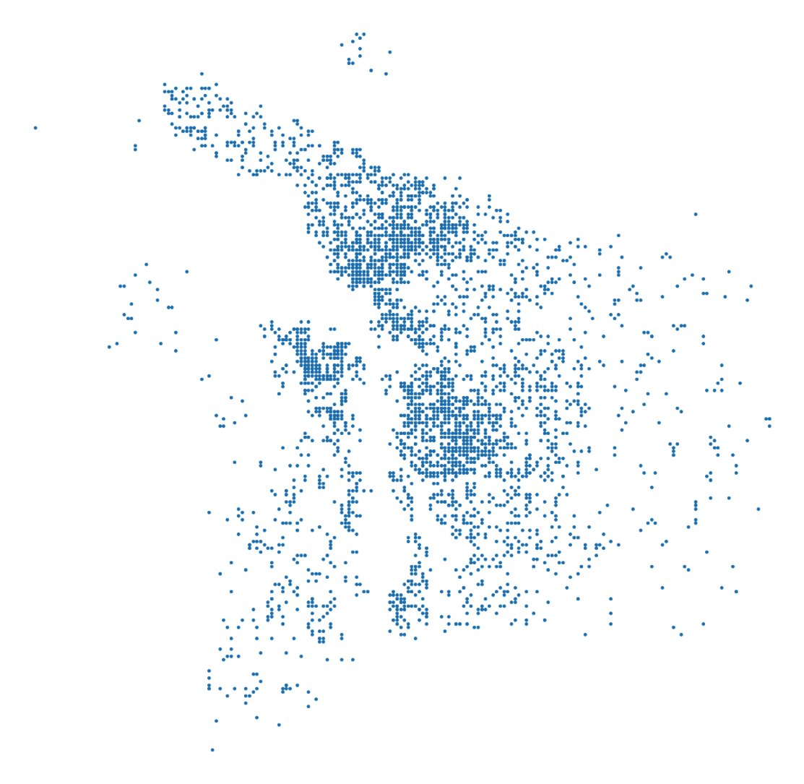
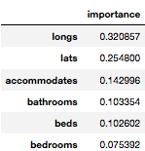
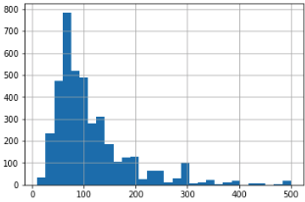
Portland
Top 3 Amenities (Phase 2):
Elevator: 6.17%
TV: 4.55%
Family/Kid Friendly: 4.31%
Best Random Forest Accuracy: 72.76%
Best Xgboost: 71.69%

Slide 19
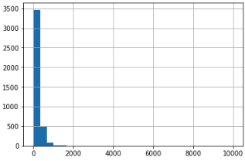
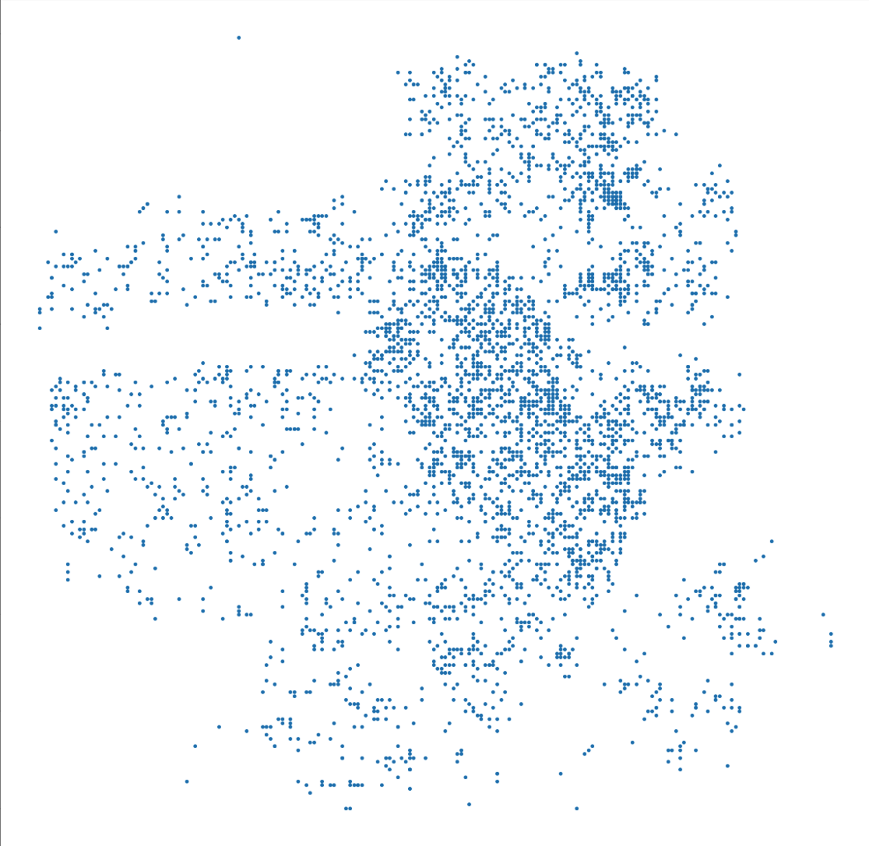
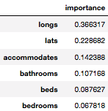
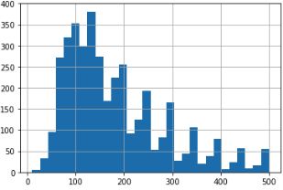
San Francisco
Top 3 Amenities (Phase 2):
Elevator in Building: 7.32%
Cable TV: 5.69%
Family/Kid Friendly 3.87%
Best Random Forest Accuracy: 69.94%
Best Xgboost Accuracy: 69.59%

Slide 20
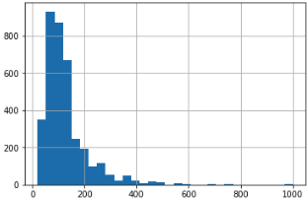

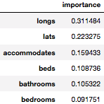
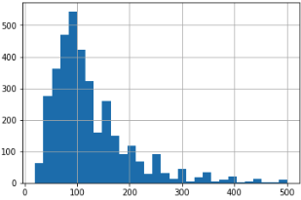
Seattle
Top 3 Amenities (Phase 2):
TV: 7.01%
Family/Kid Friendly: 3.77%
Lock on Bedroom Door : 2.43%
Best Random Forest Accuracy: 56.72%
Best Xgboost Accuracy: 58.89%

Slide 21
Upcoming Possibilities
Some possibilities for the near future would be continuing to tune the models to bring better results with less bias, as well as a usable webapp for hosts to enter their own listing data and get a second opinion.
Beyond that, understanding how the shape of a city can affect pricing of Airbnb units could provide more insight
Distance to crucial points (transportation, attractions, shopping, etc.) can almost definitely help with a model for pricing.

Slide 22
Thanks for taking a look!
A special thanks to InsideAirbnb for keeping their data open!
http://insideairbnb.com

